Slide 1
Responsible Use Of
Copyrighted & Licensed Information

Slide 2
AGENDA
The basics
  Copyright
  Fair use
  Licensing
What would you do?

Slide 3
WHAT IS COPYRIGHT?
Intended to
  Promote creation of knowledge
  Protect creators/authors
Granted automatically
Exclusive rights
Limited time
  Public domain
Notes:
Philosophical position: promote knowledge creation/progress of human knowledge

Slide 4
RIGHTS OF COPYRIGHT HOLDERS
Reproduce work
Distribute copies
Make “derivative” works
Public performance of work
Public display

Slide 5
WHAT DOES COPYRIGHT APPLY TO?
“Fixed in any tangible medium of expression”
  Books
  Articles
  Websites
  Software
  Paintings
  Sound recordings
  Architectural works
  Ballets
  Graffiti

Slide 6
WHAT DOES COPYRIGHT NOT APPLY TO?
Facts
Slogans, phrases, and titles
Processes, procedures, and methods
U.S. government works

Slide 7
WHAT IS FAIR USE?
One of many exceptions and limitations
Allows certain uses without permission or royalties
Important in education and research
Not all educational uses fair use
Good faith effort

Slide 8
FOUR FACTOR ANALYSIS
Purpose and character of the use
Nature of copyrighted work
Amount of work used
Market effect

Slide 9
WHAT IS A LICENSE?
Contractual agreement between 2 legal entities
One entity grants rights to other
Legally enforceable
Applies to…
  Databases
  Electronic journals
  Most other e-resources
Allows access and certain rights of use

Slide 10
Acceptable use
Non-commercial, educational, personal research purposes
No systematic downloading of database/journal content
No sharing materials/licensed resource access with non-U people
  Unless license permits
  Includes usernames/passwords

Slide 11
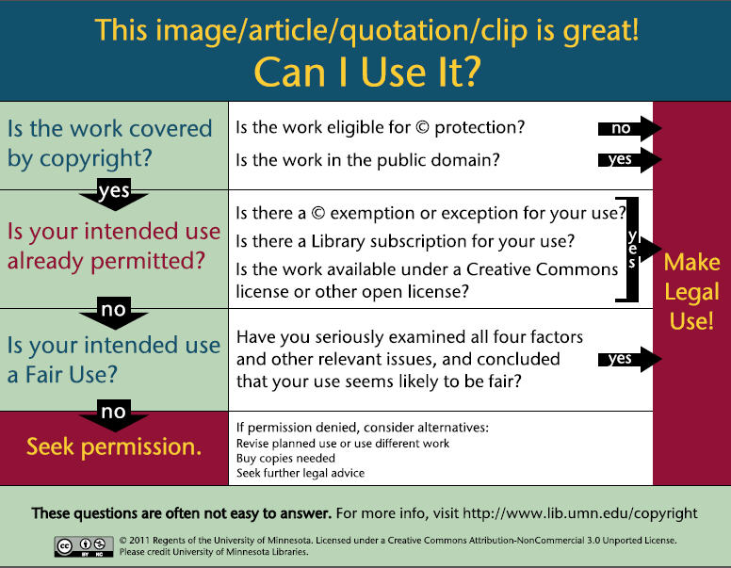

Slide 12
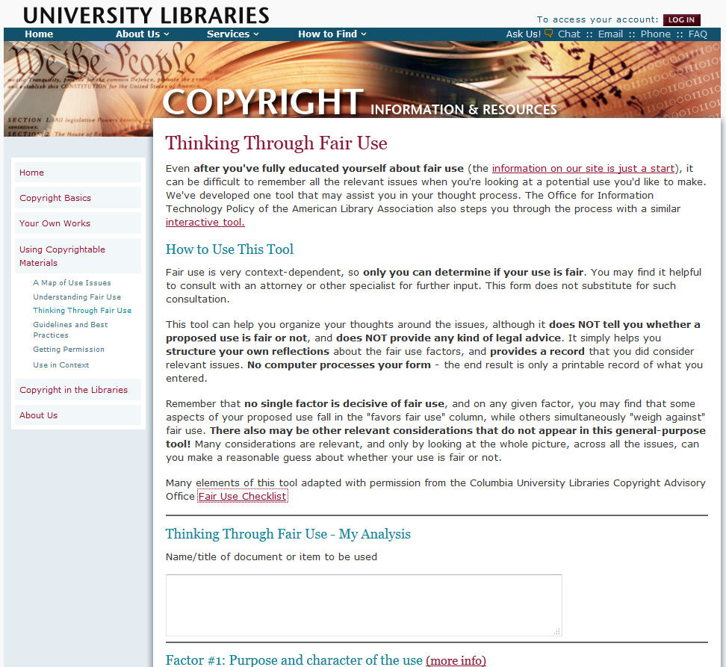

Slide 13
FAIR USE SCENARIOS
Five situations
Is it or isn’t it?
If not
  Get permission
  Find an alternative

Slide 14
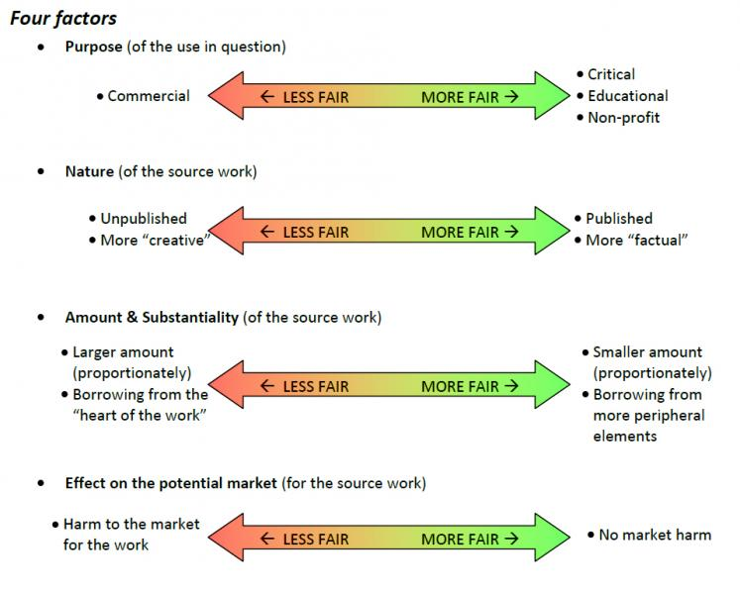

Slide 15
COPYRIGHT RESOURCES FOR AUTHORS

Slide 16
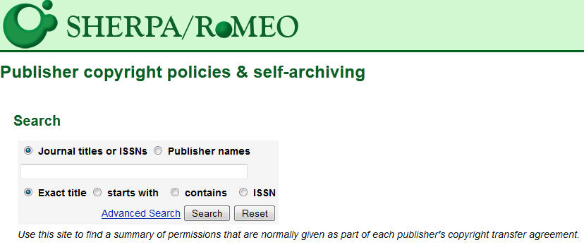

Slide 17
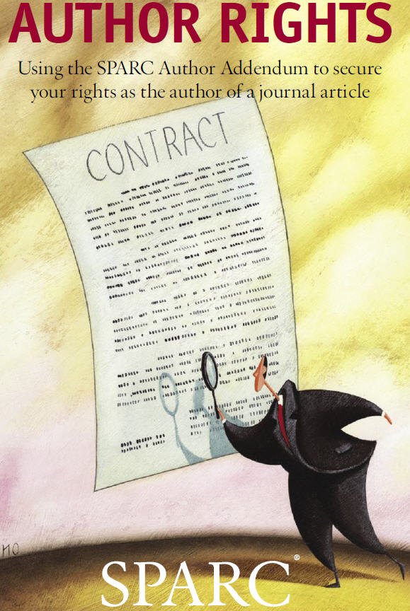
http://www.arl.org/sparc/author

Slide 18
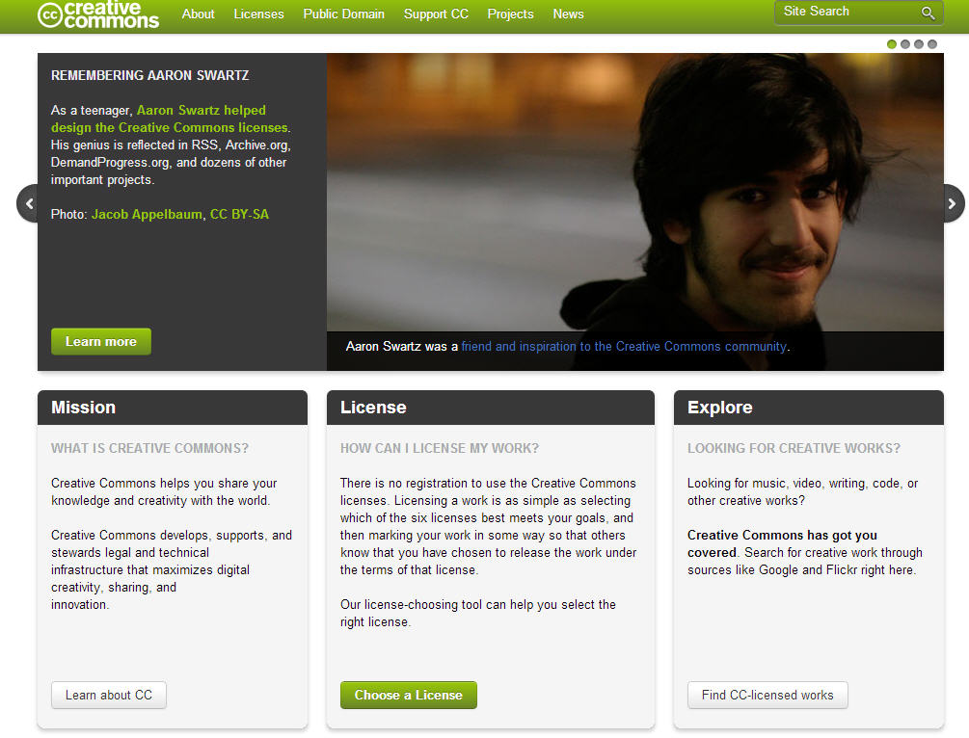

Slide 19
CAMPUS COPYRIGHT RESOURCES

Slide 20
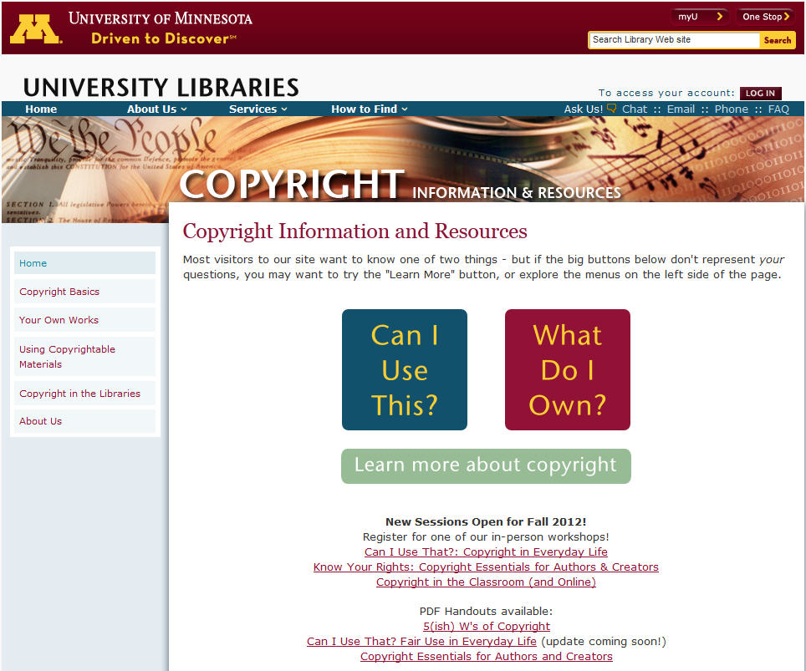

Slide 21
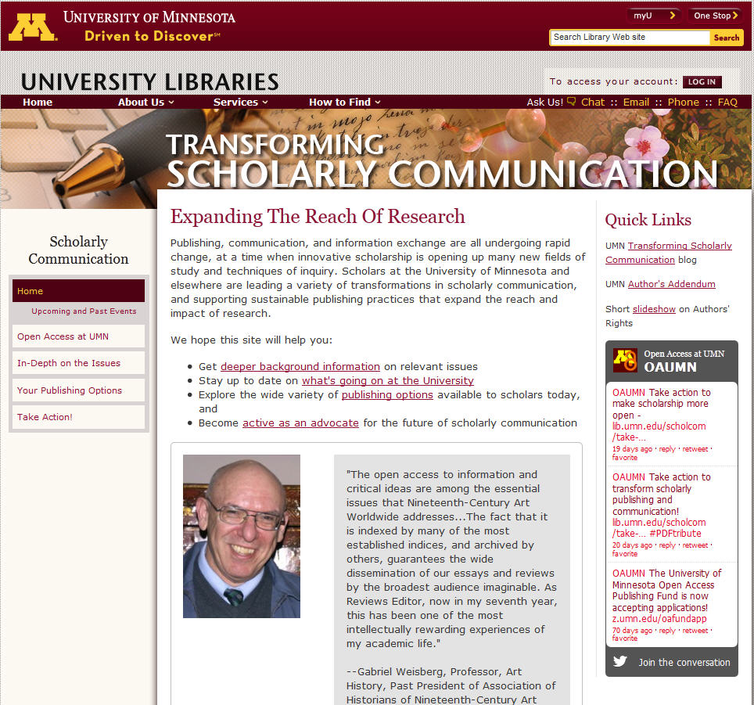

Slide 22
